Slide 1

MIA Pipeline – Registration
Luca Sahli, Jacob Rasmussen and Camilo Mendez MIA-Lab
Fall 2017

Slide 2
Overview
Introduction
Affine Transformation
Methods
Optimization
Result 1
Bspline Transformation
Methods
Result 2
Conclusions
Outlook

Slide 3
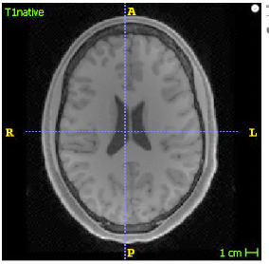
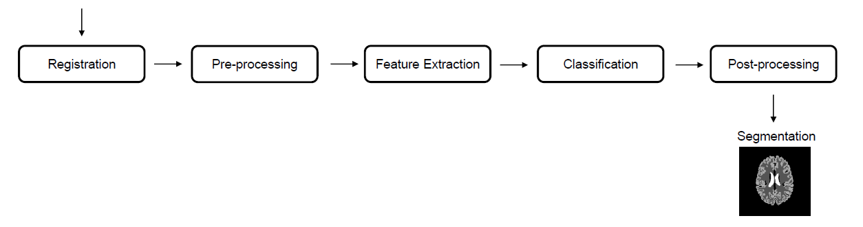
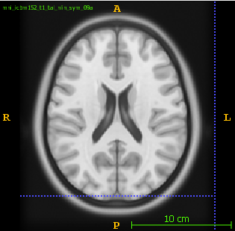
MIA Pipeline
T1_native
T1_mni

Slide 4
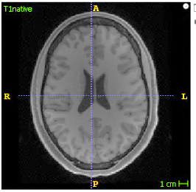
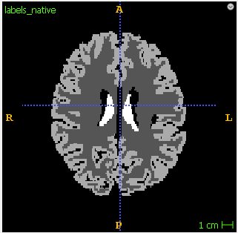
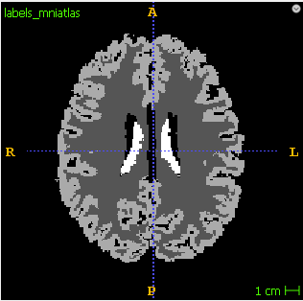
Registration Pipeline
T1_native
labels_native
labels_registerd
TAffine
Registration
Transformation
Evaluation
Dice
T1_mni
Labels_registerd
labels_mniatlas

Slide 5
Affine
Affine

Slide 6

Affine Registration
We use AffineRegistration() from the SimpleITK library
def __init__(self, number_of_histogram_bins: int=200,
learning_rate: float=1.0, step_size: float=0.001, number_of_iterations: int=200, relaxation_factor: float=0.5,
shrink_factors: [int]=(2, 1, 1), smoothing_sigmas: [float]=(2, 1, 0),
sampling_percentage: float=0.2):

Slide 7
Optimization
Pseudocode for optimization
FOR EACH Setting of parameters
FOR 10 patients
Dice[White, Grey, Ventricles] = evaluate()
SAVE mean Dice over the 10 patients
CHOOSE setting with highest Dice
Notes:
- Number of histogram bins
- Learning rate
- Step size
- Number of iteration
- Shrinking factor
- Smoothing sigma

Slide 8
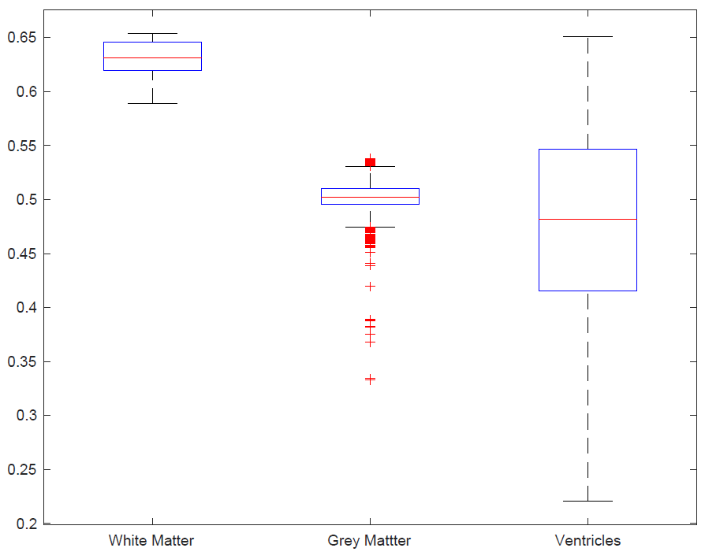
Result 1
Affine transformation
Best Parameters:
.
.
.
Best Dice:
.
.
.

Slide 9
BSpline
BSpline

Slide 10
BSpline Registration
We use BSplineRegistration() from the SimpleITK library
def __init__(self,
number_of_bins: int = 50,
number_of_iterations: int = 1500,
gradient_Convergence_Tolerance: float = 1e-5,
max_number_of_corrections: int = 100,
max_number_of_function_evaluations: int = 1000,
cost_function_convergence_factor: float = 1e+7,
sampling_percentage: float = 0.2,
transformDomainMeshSize = [10,10,10]):

Slide 11
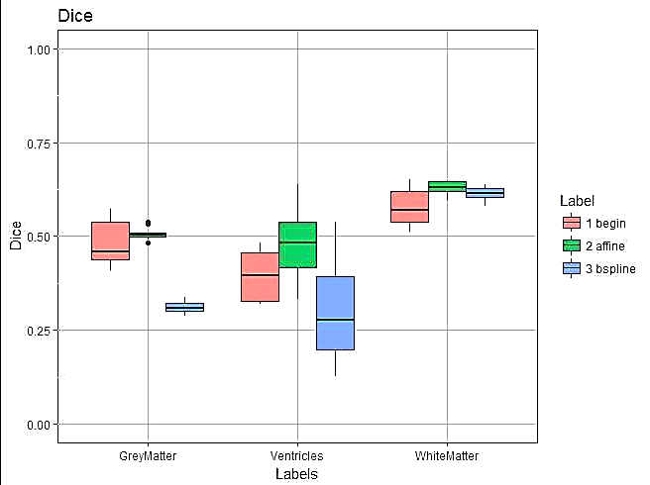
Result 2
Pseudocode for optimization

Slide 12
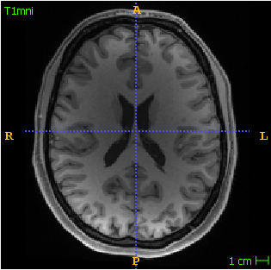
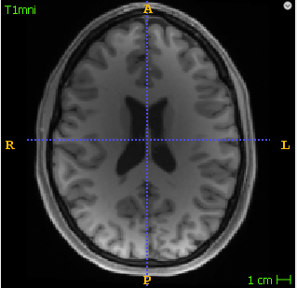
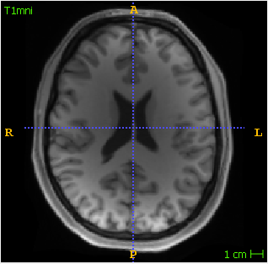
Result 2
Begin
Affine
BSpline
Dice:
White matter 0.51
Grey matter 0.42
Ventricles 0.33
Mean 0.42
Dice:
White matter 0.62
Grey matter 0.48
Ventricles 0.64
Mean 0.58
Dice:
White matter 0.64
Grey matter 0.31
Ventricles 0.51
Mean 0.49

Slide 13
Conclusions
SimpleItk is a powerful toolkit
contains lots of implemented functions for registration
Limited results for affine transformations
BSpline transformation seem to be very promising
Locally better results (ventricles, bulks in skull)
However, there are difficulties in choosing right parameters.

Slide 14
Outlook
SimpleElastix

Slide 15
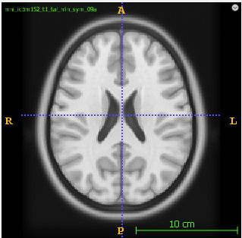
Introduction: Registration Pipeline
1. registration
2. transformation
TAffine
T1_native
T1_mni
labels_
native
Labels_
registerd
TAffine
3. evaluation
Dice
labels_
registerd
labels_
mniatlas

Slide 16
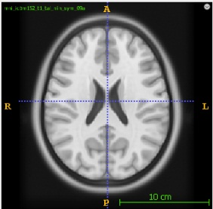
Introduction - sequence
Registration
TAffine
T1_native
T1_mni
TAffine
labels_registerd
labels_native
labels_registerd

Slide 17
Introduction - evaluation
Evaluator
Dice coefficients
labels_registerd
labels_mniatlas/
ground truth

Slide 18
Methods
histList = [10, 50, 100, 200, 300]
learnRateList = [0.1, 0.2, 0.9]
iterList = [100, 200, 1000]
Patient 1
Patient 2
Patient 3
…
Patient 10
..
..
..
..
..
..
..
..
..
..
..
..
..
..
..
mean
..
..
..

